Slide 1
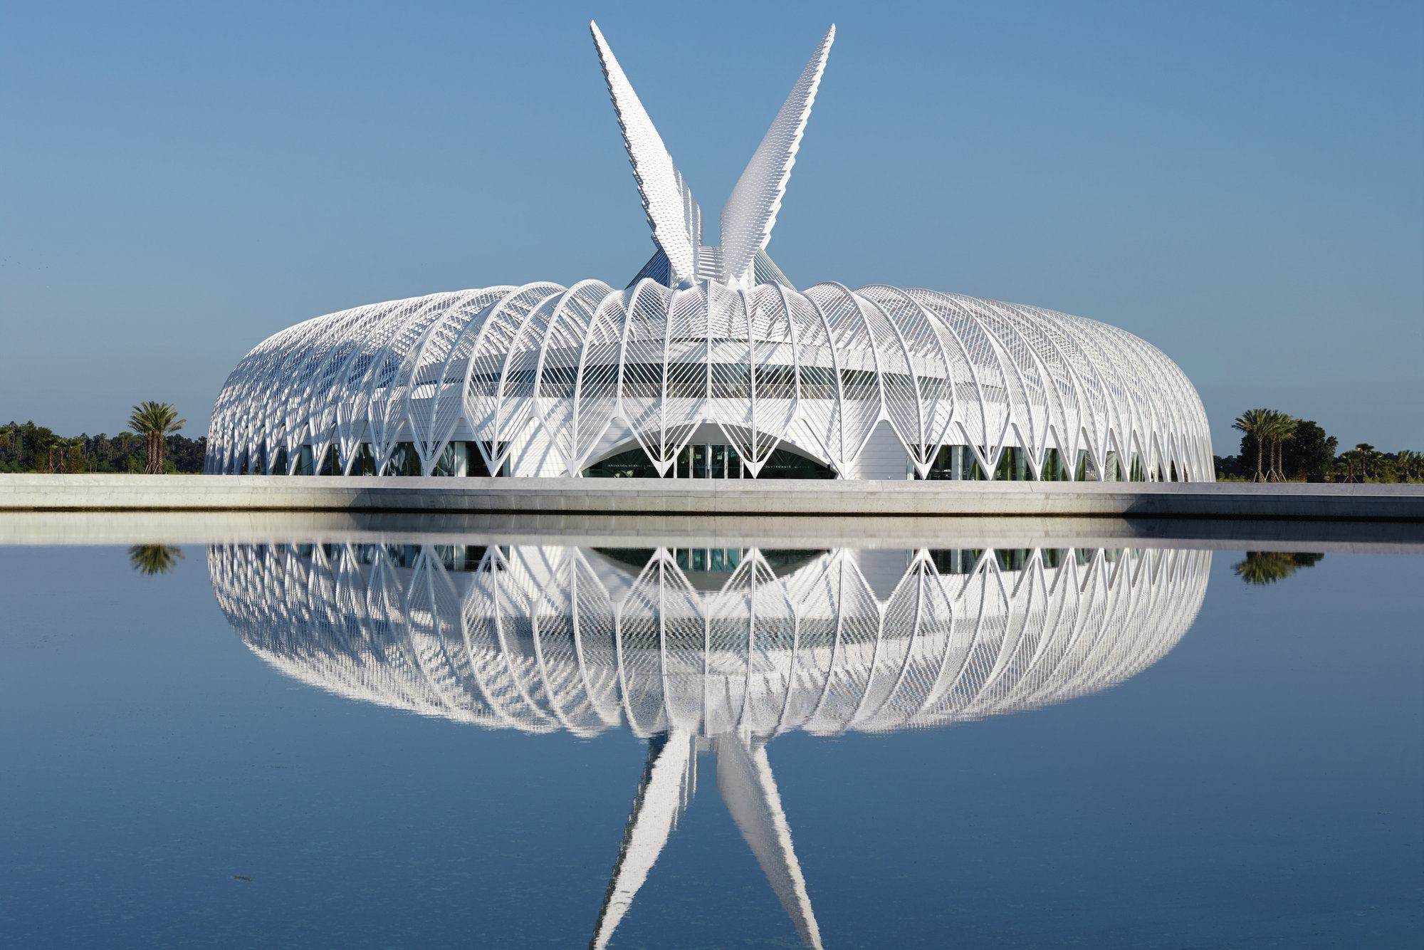
Student INFOSEC TEAM
SIT@FPU

Slide 2
Club Vision

Slide 3
Vision of the Student Infosec Team
Create a community of students dedicated to improving themselves and the environment around them, specifically by creating a peer learning environment.
Enable students to learn skills to perform Information Security exercises competitively.
Enable students to excel in the workplace, in their internships, and in professional interactions.

Slide 4
Why Infosec (terminology)
The Information Security world respects and recognizes the terminology “Infosec”.
The term “Cybersec” has more sex appeal but is not respected.
The term “Cybersec” implies that physical security is not included in this area of study. Information Security requires a consistent and holistic philosophy when designing secure systems in any real environment.

Slide 5
Information Security in 2019
BUSINESS AND MILITARY NEEDS

Slide 6
Defensive Security
Most infosec jobs available focus on defensive security.
There is a fear of losing information, having information extracted by unauthorized parties, or getting “hacked”
These involve positions relating to application security, network security, and physical security
Policymaking is a meta job in defensive security

Slide 7
Offensive Security
Offensive security normally involves some sort of “penetration testing”
At SIT and SIT events, there will be CTF (Capture the Flag) competitions
CTFs involve retrieval of some key or piece of information
Sometimes there is more than one way to access or find the key
Many CTFs have multiple challenges and offer points for completing challenges
<CTF Story Time>

Slide 8
Independent Learning
THE IMPORTANCE OF SELF STUDY AND WHERE TO FIND RESOURCES

Slide 9

How to effectively self-study
Reduce and Eliminate DISTRACTIONS
Pick A Spot Where you can learn consistently
Set Goals And Create A Plan

Slide 10


Make a Plan
Determine the skills that you need to acquire
1
Set deadlines for learning milestones, register for classes, form a study group with like-minded people
2
Practice, study and discuss content with peers,
3

Slide 11
Information on Certifications
Certifications show that you have completed standardized programs designed to test competency in a specific topic valued by industry.
Certification programs are robust and offer learners a chance to complete programs made to help them learn a skill beyond an elementary understanding.
Certifications so not take long to learn and may be the most concise programs a learner can participate in to learn a skill.
Certifications show employers that time spent on job training will be minimal and give them a clear picture of your aptitudes.
Polk State offers IT certification programs. Each program is worth three college credits and takes up the same amount of study time as a regular three credit class.
Online certification programs are available and allow learners to work ahead or work on their own time.
Santa Fe College in Gainesville has an online IT program with security and networking certifications. A student may apply and complete these programs online, which may be favorable for students that cannot or do not want to drive between institutions.

Slide 12
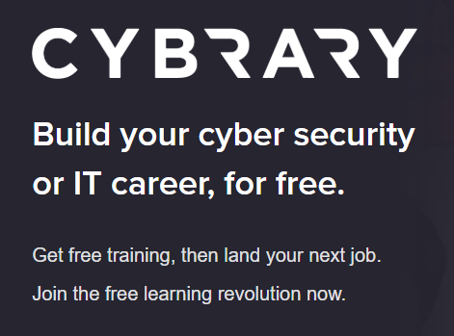
cybrary.it
Cybrary is an online resource containing dozens of prep courses.
Cybrary contains information on many Infosec topics and has coherent, guided programs for the self learner.

Slide 13
Introductions, Q & A
Introduce yourself

Slide 14
Introduce yourself
Name
Major
Concentration (if any)
Personal interests or interests in specific Infosec topics

Slide 15
Other Information
If anyone wants to present their senior projects or speak on a topic, you may talk to the eboard about it and we will try to set a date.
If anyone is interested in becoming a team captain or taking up a leadership role in the club, speak with the eboard.

Slide 16
Questions?
Next >> $SHELL

Slide 17

Thank you
floridapoly.slack.com #cybersec_sit

